Slide 1





Chongqing University of Technology
ATAI
^{Chongqing} Advanced Technique
University of of Artificial
_{Technology} Intelligence
Chongqing ^{ATAI}
Advanced
University of _{logy Technique of}
Technology
Chongqing University of Technology
Chongqing University of Techno
Intelligence
FineRec: Exploring Fine-grained Sequential Recommendation
https://github.com/Zhang-xiaokun/FineRec
—— SIGIR 2024
Reported by Yuyang Lai
1

Slide 2


Chongqing University of Technology
ATAI
^{Chongqing} Advanced Technique
University of of Artificial
_{Technology} Intelligence
Chongqing
C^{U}ho^{n}n^{i}g^{v}q^{e}in^{r}g^{s}U^{it}n^{y}iveºr^{f}sity of Technollooggyy
Technology
Chongqing University of Techno
f
Intelligence
1.Introduction 2.Method
3.
2

Slide 3



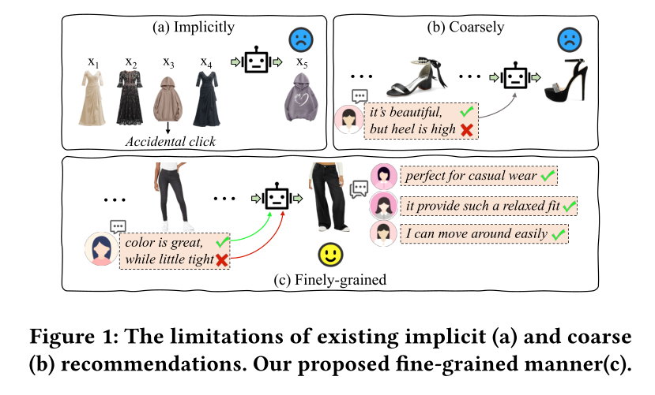
ATAI
^{Chongqing} Advanced Technique
University of of Artificial
Intelligence
Chongqing University of Technology
implicit actions, like accidental clicks, can sometimes misrepresent user interests, thereby introducing noise into the models .
coarsely treat a review as a whole, overlooking the fact that users may have distinct opinions about different attributes within a single review.

Slide 4
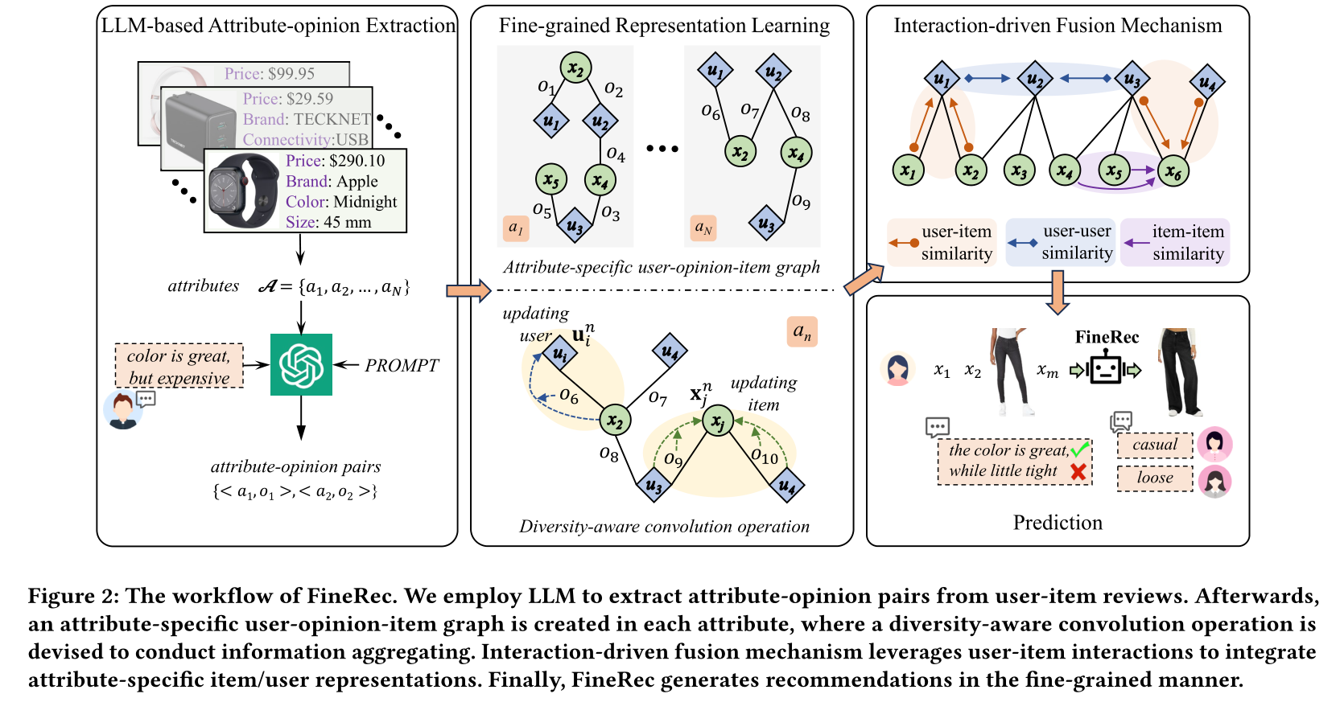
ATAI
ATAI
^{Chongqing} Advanced Technique
University of of Artificial
Intelligence
Chongqing University of Technology
Advanced Technique
of Artificial Intelligence

Slide 5






ATAI
ATAI
^{Chongqing} Advanced Technique
University of of Artificial
Intelligence
Chongqing University of Technology
Advanced Technique
of Artificial Intelligence
"it smells nice, but too expensive"

Slide 6




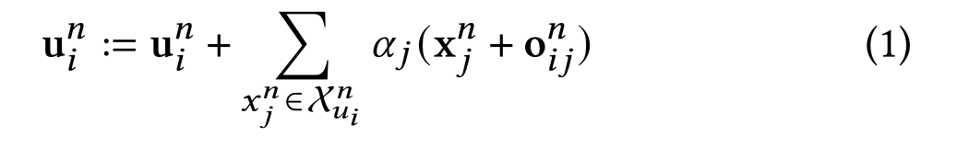
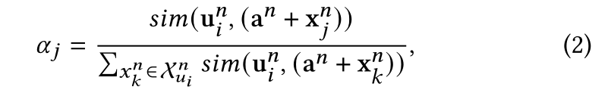
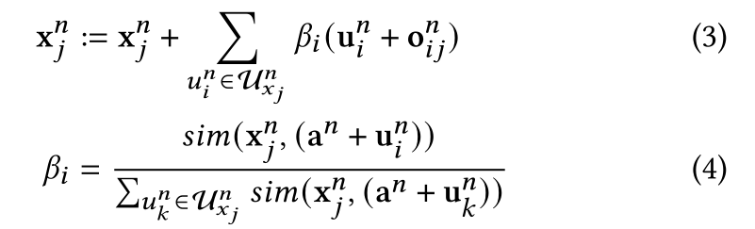
ATAI
ATAI
^{Chongqing} Advanced Technique
University of of Artificial
Intelligence
Chongqing University of Technology
Advanced Technique
of Artificial Intelligence

Slide 7
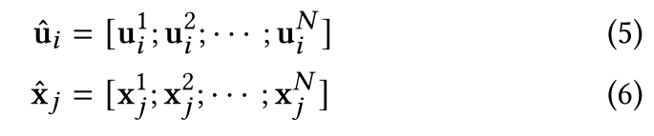
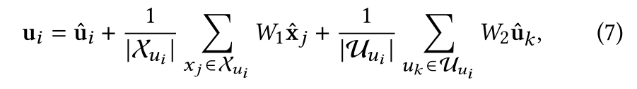
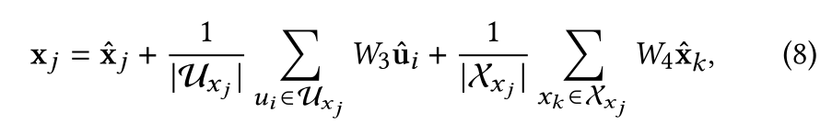
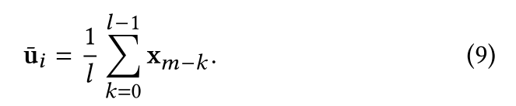

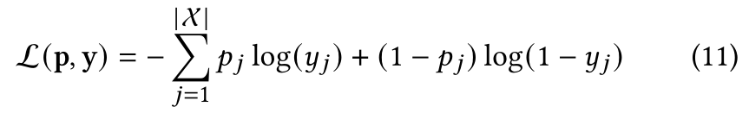
ATAI
ATAI
^{Chongqing} Advanced Technique
University of of Artificial
Intelligence
Chongqing University of Technology
Advanced Technique
of Artificial Intelligence

Slide 8

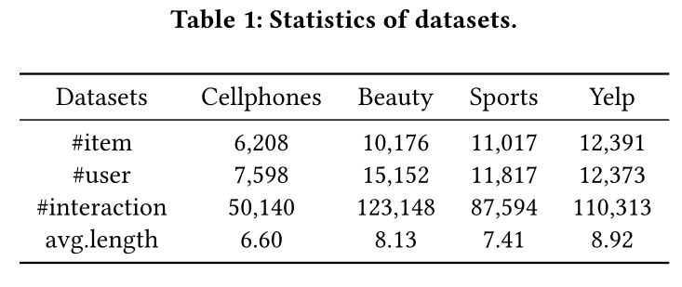
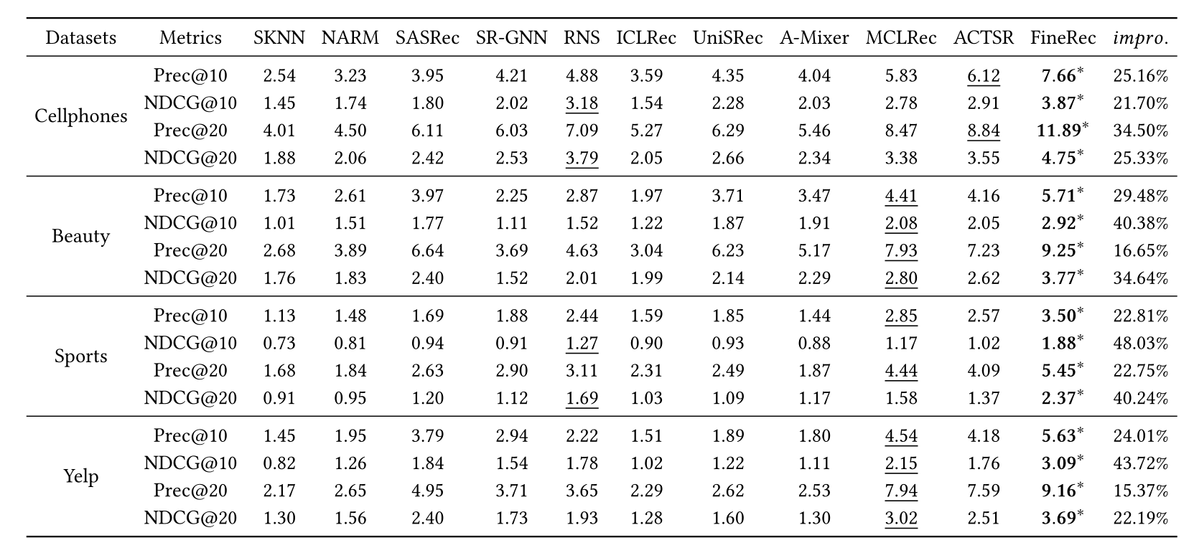
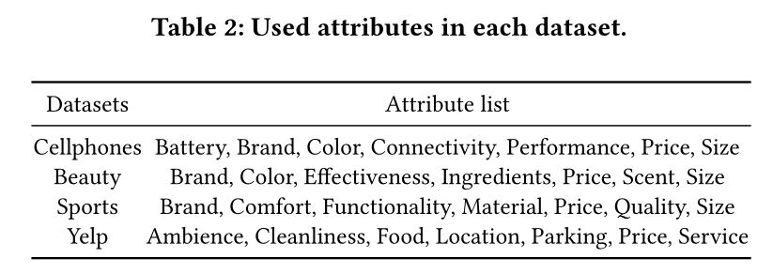
ATAI
ATAI
^{Chongqing} Advanced Technique
University of of Artificial
Intelligence
Chongqing University of Technology
Advanced Technique
of Artificial Intelligence

Slide 9
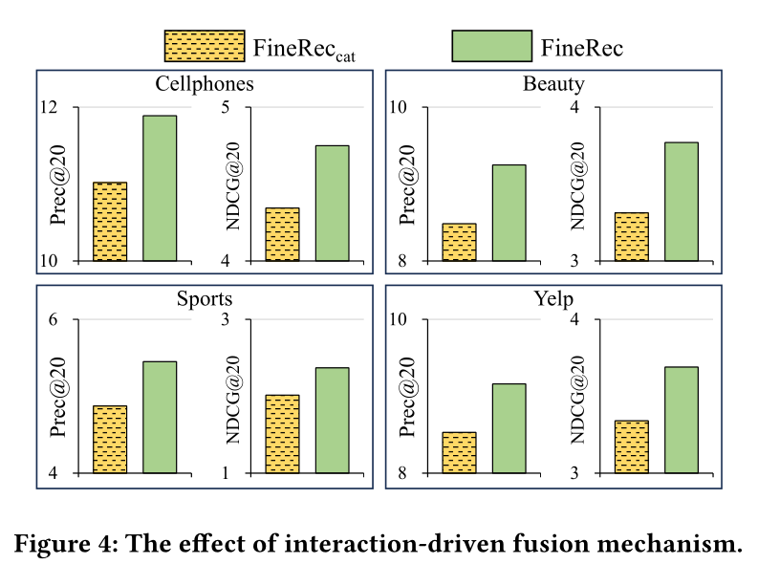
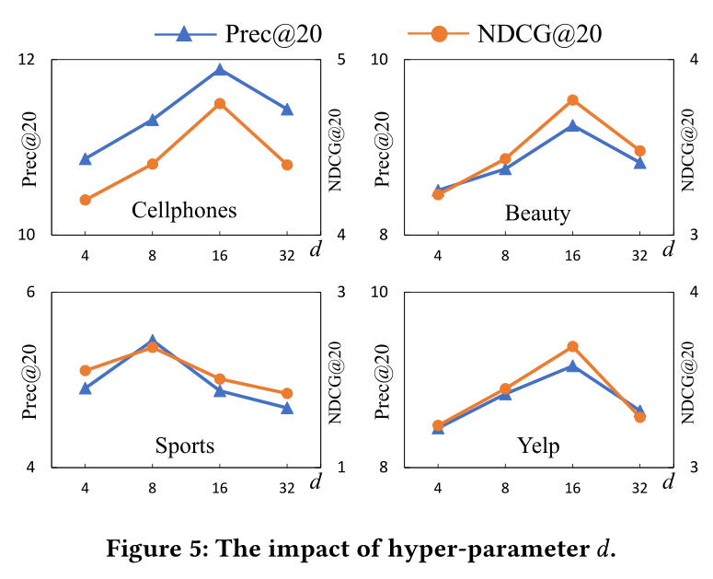
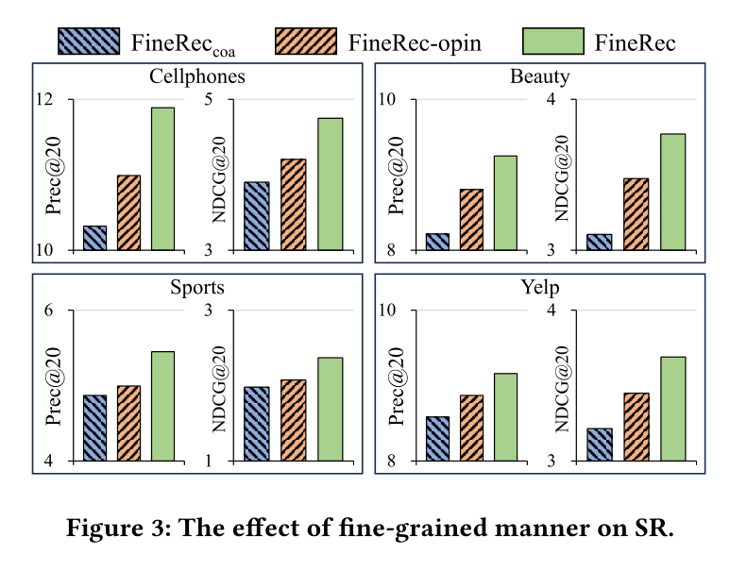
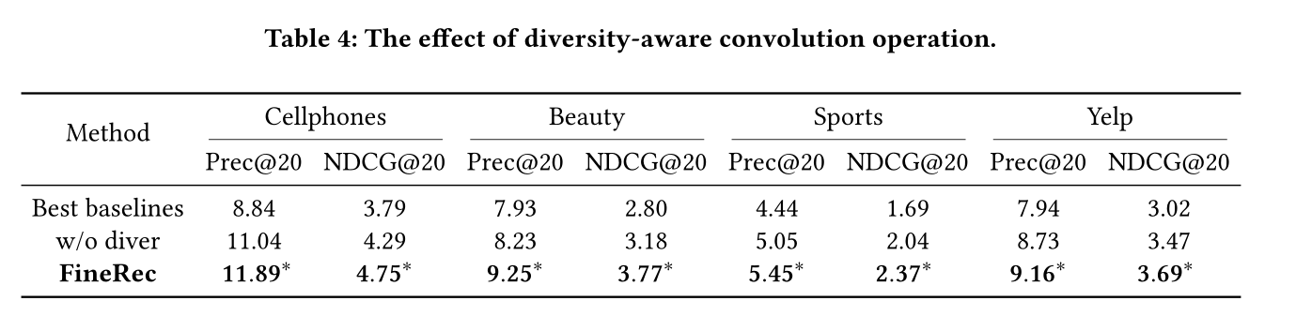
ATAI
ATAI
^{Chongqing} Advanced Technique
University of of Artificial
Intelligence
Chongqing University of Technology
Advanced Technique
of Artificial Intelligence

Slide 10
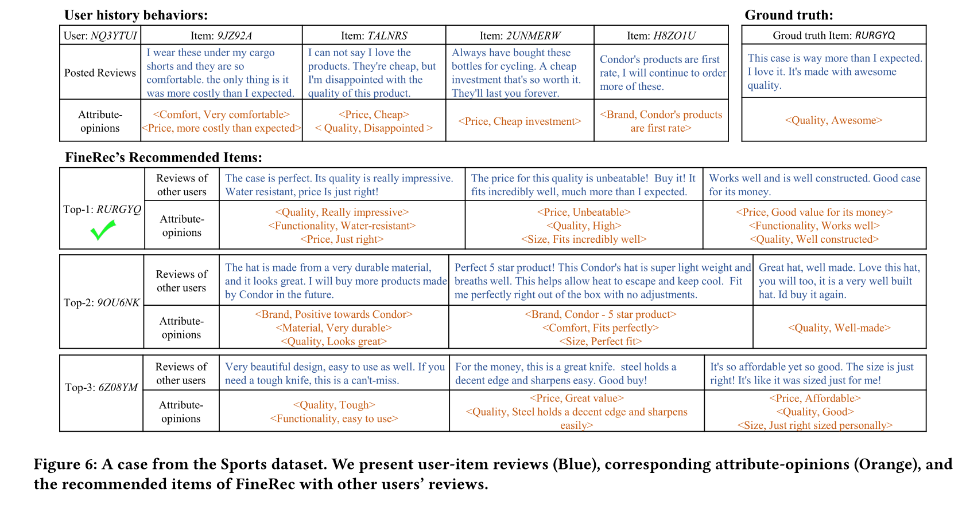
ATAI
ATAI
^{Chongqing} Advanced Technique
University of of Artificial
Intelligence
Chongqing University of Technology
Advanced Technique
of Artificial Intelligence

Slide 11

ATAI
ATAI
^{Chongqing} Advanced Technique
University of of Artificial
Intelligence
Chongqing University of Technology
Advanced Technique
of Artificial Intelligence

